Slide 1

DAYANANDA SAGAR ACADEMY OF TECHNOLOGY AND MANAGEMENT
Udayapura, Kanakapura Road, Bangalore-560082
2023 - 2024
DEPARTMENT OF ELECTRONICS AND COMMUNICATION ENGINEERING
Major Project(18ECP83)
Review-II
Team members:
Aditi Jaiswal - 1DT20EC003
Aditi Mitra - 1DT20EC004
Damini Kashyap - 1DT20EC012
Diksha Kumari - 1DT20EC013
Guide:
Dr. Tripti R Kulkarni
Assistant Professor,
Department of ECE

Slide 2
Outline
Introduction
Problem Statement
Objectives
Block Diagram
Methodology
Flowchart
Hardware and Software Requirement
Quality Metrics
Conclusion
References

Slide 3
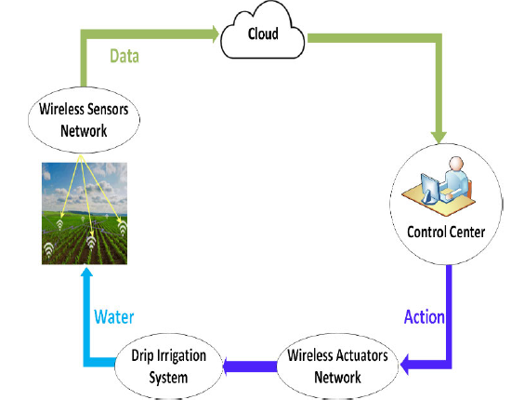
Introduction
Agriculture, the foundation of human civilization, is at a critical juncture. Traditional methods, while time-honored, struggle with resource constraints and environmental sustainability. To address these challenges, we present Smart Agriculture, a transformative initiative to revolutionize farming practices. Integrated with IoT (Internet of Things), cloud computing, and intelligent control systems.
Smart Agriculture empowers farmers to optimize resource utilization, enhance crop yields, and minimize environmental impact.
A key aspect of Smart Agriculture lies in its adoption of renewable energy sources. By harnessing the power of the sun, Smart Agriculture systems eliminate reliance on fossil fuels, reducing carbon emissions and promoting a cleaner agricultural landscape

Slide 4
Literature Survey

Slide 5
S no. | Title and Author | Journal and Year | Observations | Take Away Points
1. | Internet of Things (IoT) for Smart Precision Agriculture and Farming in Rural Areas Nurzaman Ahmed, Debashis De , Senior Member, IEEE, and Md. Iftekhar Hussain, Member, IEEE | IEEE,2020 | The paper addresses challenges in rural precision agriculture by integrating Wireless Sensor Networks (WSN) and Wireless Long Distance (WiLD) networks. The practical evaluations validate the proposed framework's real-world applicability, showcasing the effectiveness of dynamic fog computing in reducing latency | Local Decision Power: Utilize fog computing to enhance smart agriculture systems with local decision-making, reducing dependency on distant cloud resources.
2 | IOT based Smart Agriculture Monitoring and Irrigation System Authors: Swaraj C M ,PES College of Engineering ,Mandya, Karnataka, India K M Sowmyashree ,PES College of Engineering ,Mandya, Karnataka, India | International Journal of Engineering Research & Technology (IJERT),2020 | The paper explores IoT's role in agriculture, utilizing Wireless Sensor Networks for real-time monitoring and automation, enhancing efficiency, and contributing to global warming mitigation and ecological balance. | The paper emphasizes the impactful integration of IoT, specifically Wireless Sensor Networks, in agriculture, offering real-time monitoring and automation for climate and soil conditions.

Slide 6
S no. | Title and Author | Journal and Year | Observations | Take Away Points
3. | IOT-Based Smart Agriculture Using Cloud Based Storage Author- Rakesh Mali , Shailesh Bendali | International research journal of Modernization in Engineering Technology and Science November(2022) | The paper concludes by highlighting the potential of SA to revolutionize agriculture by promoting efficient water usage, reducing reliance on fossil fuels and increasing agriculture productivity. The proposed SA system, with its open resource implementation, cloud based data management, fuzzy logic control and renewable energy integration, provides viable source to sustainable agriculture. | The use of fuzzy logic control provides flexibility and adaptability in irrigation scheduling, accounting for variations in soil conditions and weather patterns.
4. | Solar energy powered smart farm irrigation system. Authors: Ahmad Al Nabulsi, Shayok Mukopadhayay, Muhammad Shihab Awal. | Journal of Electronic science and technology- 2021 | This paper proposes an IoT-based solar energy system for smart irrigation to address water scarcity and power shortage challenges in agricultural regions. The system aims to automate and optimize irrigation while minimizing water and energy consumption. | The key takeaway point is the proposed IoT-based solar energy irrigation system addresses water scarcity and power shortage issues in agriculture. The system integrates sensor data, fuzzy logic control, and remote monitoring to optimize irrigation and resource usage.

Slide 7
S no. | Title and Author | Journal and Year | Observations | Take Away Points
5. | Internet of things in smart agriculture applications and open challenges. Authors: Vivek Bhatnagar, Gulbir singh, Gautam kumar, Rajeev Gupta. | International journal of students Research in technology and management- January 2020 | By embedding sensors and actuators in agricultural equipment and infrastructure, IoT can provide farmers with real-time data and insights into their crops and fields, enabling them to make better decisions about irrigation, fertilization, pest control, and other aspects of crop management. | The key takeaway point is that IoT can be used to monitor a wide range of parameters in the field, including temperature, humidity, soil moisture, nutrient levels, and pest infestation. IoT can be used to automate and optimize irrigation systems, saving water and energy.
6. | A Survey on Smart Agriculture : Development mode Technologies and Security Privacy Challenges. Author-Xing Yang, Lei shu, Kai huang, Jianing chen, Jun wu | IEEE/CAA JOURNAL OF AUTOMATICA SINICA, VOL. 8, NO. 2, FEBRUARY 2021 | The paper concludes by emphasizing the importance of addressing security and privacy challenges in smart agriculture to ensure the sustainable and secure development of this emerging field. | Investigating the use of fog computing to provide distributed data processing and security capabilities at the edge of the network.

Slide 8
Problem Statement
Traditional agriculture struggles with inefficient water usage, limited data for decision-making, reliance on fossil fuels, and labor-intensive processes. This project proposes a solution that integrates renewable energy, IoT technology, and cloud-based data management to address these challenges.

Slide 9
Objectives
Cost-Effective Sustainability: Develop an affordable and sustainable smart agriculture system using open-source technologies and renewable energy sources.
Resource Optimization: Implement intelligent irrigation control to optimize water and energy consumption, aiming to reduce waste and enhance efficiency.
IoT and Cloud Integration: Utilize IoT devices and a Cloud-Based Platform for real-time data processing and visualization, enabling advanced monitoring and precision agriculture practices
Smart irrigation systems estimate and measure reduction of existing plant moisture in order to operate an irrigation system, restoring water as needed while minimizing unwanted water use.
Alert and Notification System: Farmers will get the insights of their crop on their mobile phones and a crop prediction favourable to their soil conditions.

Slide 10
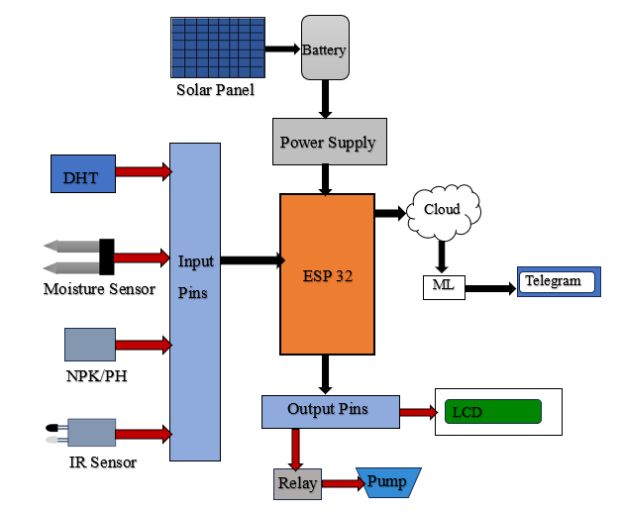
Block Diagram

Slide 11
Pin Diagram of ESP32

Slide 12
Methodology
1. Data Acquisition
Sensor Deployment: Various sensors are deployed throughout the soil to collect real-time data
Soil Moisture Sensor, DHT11, IR Sensor
2. Data Transmission and Cloud Integration
The ESP32 acts as a central hub, receiving data from the sensors and transmitting it to the cloud platform. We have used Thingspeak server to store and visualise the data.
3. Automation and Control
The threshold value of moisture sensor determines whether the soil is dry or wet, based on that the motor turns ON and OFF thus implementing Smart Irrigation.
The data from ThingSpeak server is being read into the ML model for Crop Recommendation System.
Random Forest Algorithm is implemented to predict the crop favourable to grow in that soil.
The predicted crop alongwith the other sensor data is being sent to the farmers on their Telegram as an alert notification system.
4.Renewable Source of energy integration:
Solar panel is used to provide required power to the system.

Slide 13
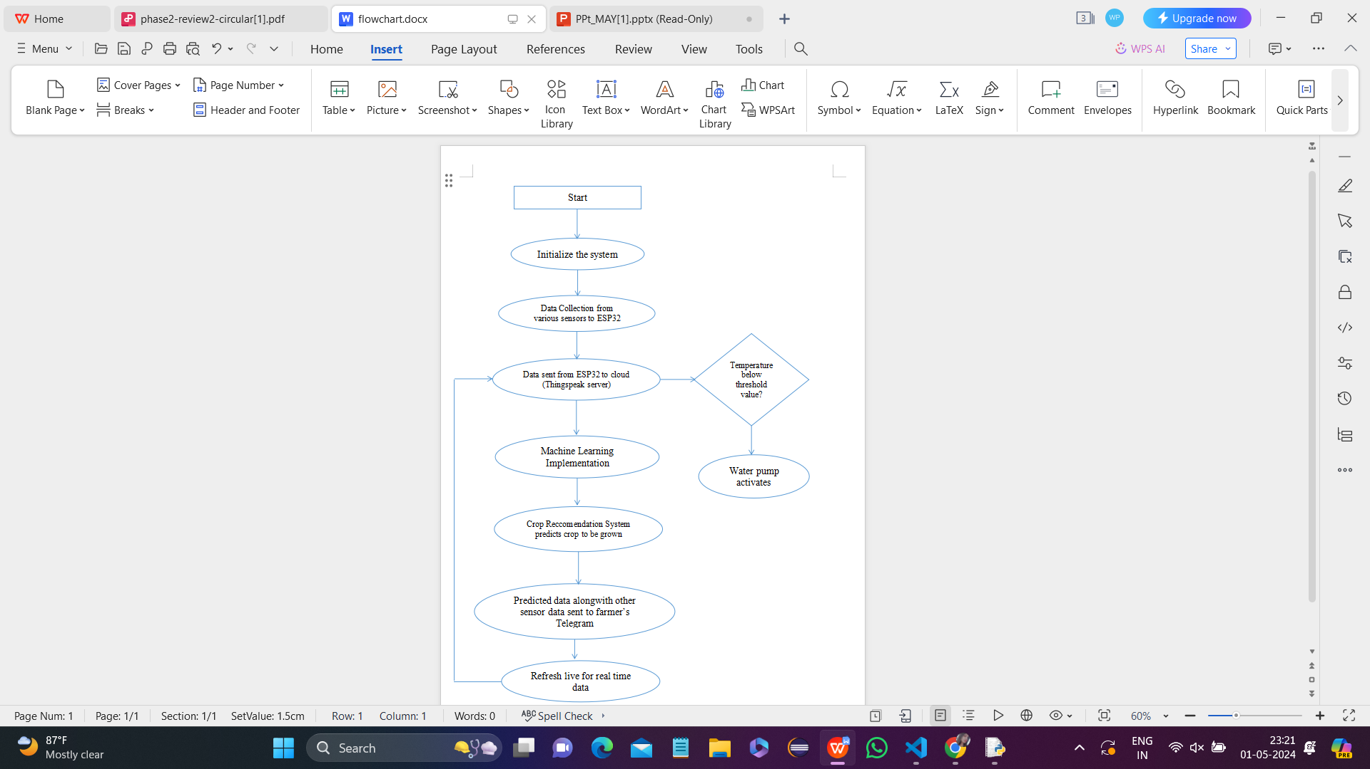
Flowchart

Slide 14
Hardware and Software Requirements
HARDWARE-
ESP32
Battery(12V)
Power supply
LCD(16X2)
Solar Panel
Sensors(Soil moisture,DHT11,IR Sensor)
PH meter
Relay
Pump
SOFTWARE-
ThingSpeak server
Arduino IDE programmed in C
Python IDLE 3.7

Slide 15
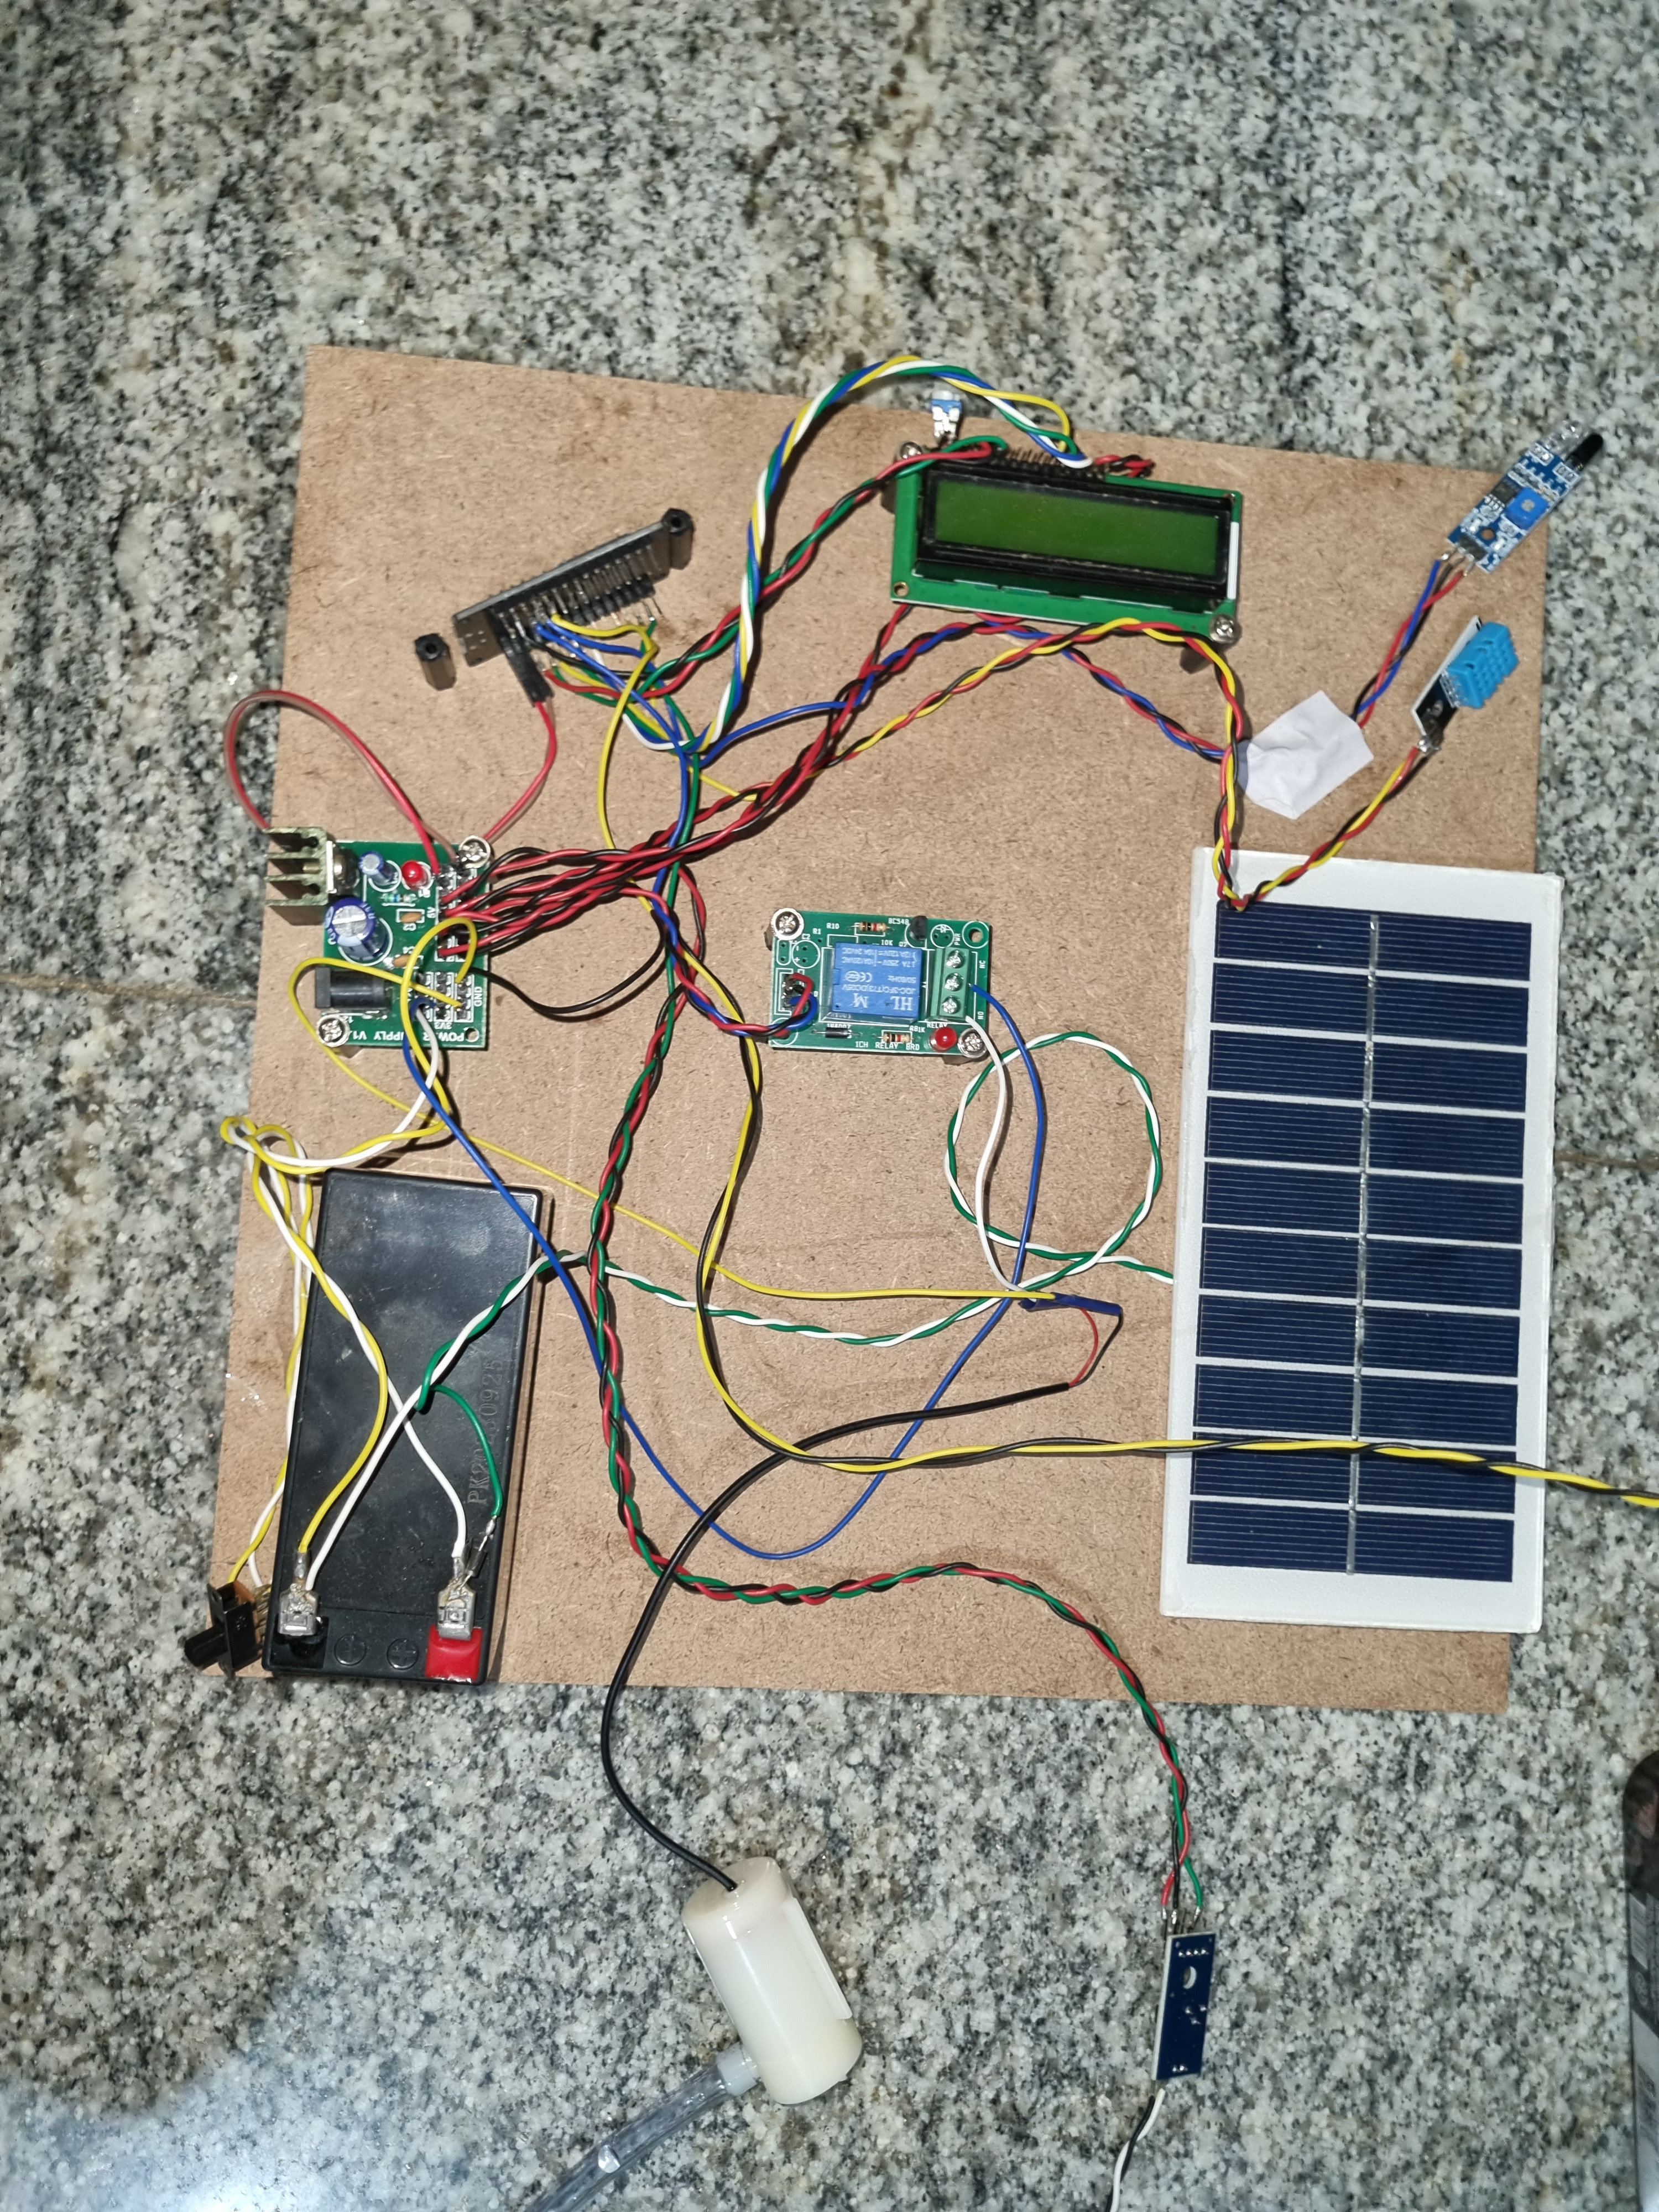
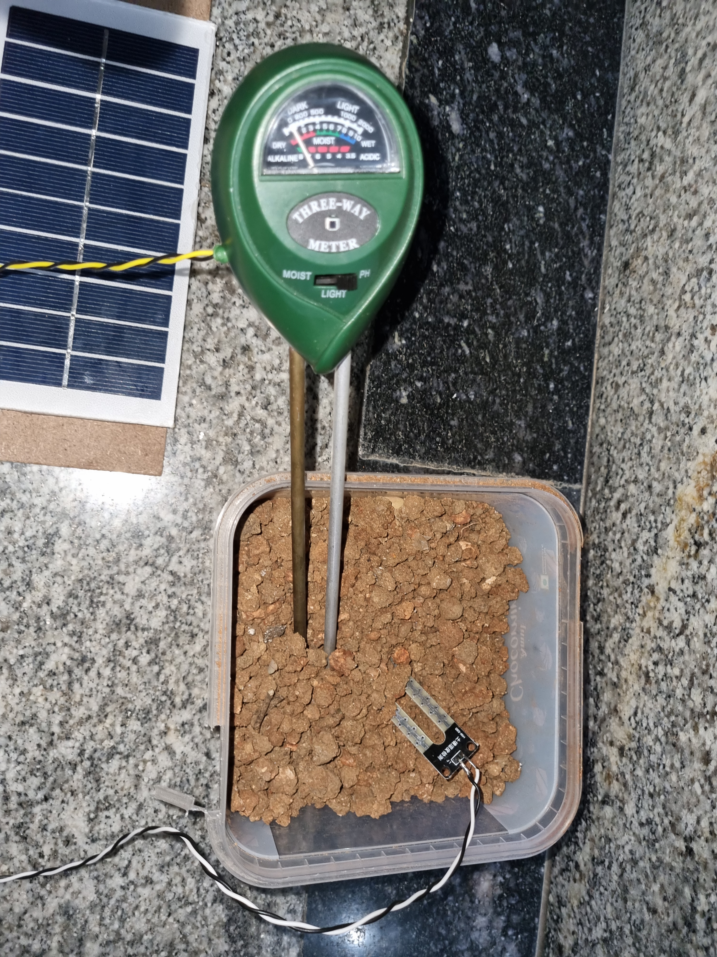
Project Implementation
Hardware Implementation of Project

Slide 16
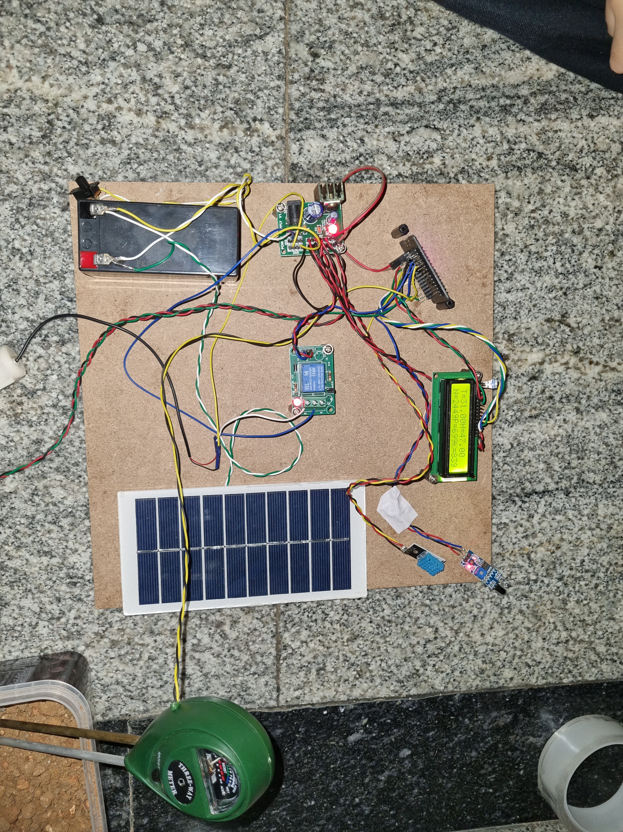
Experimental Results
Hardware setup when ON

Slide 17
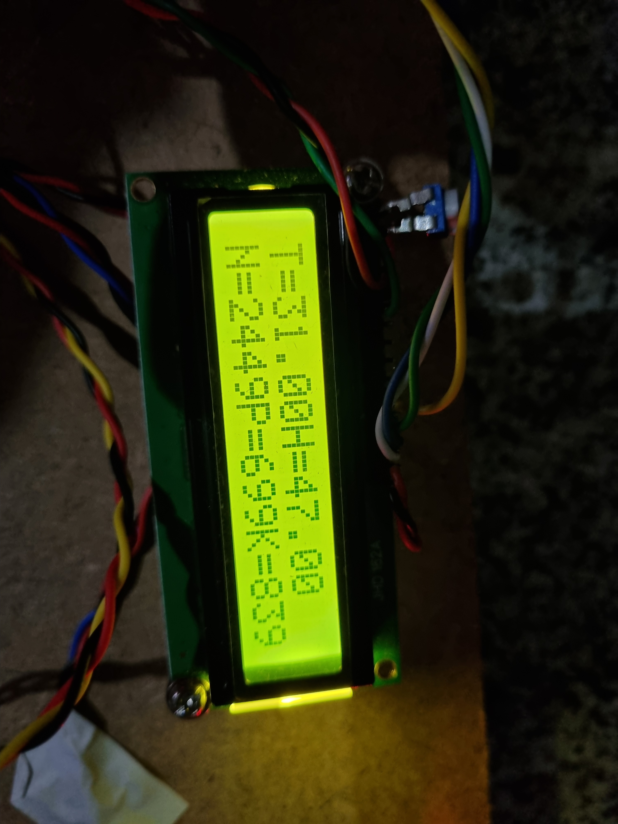
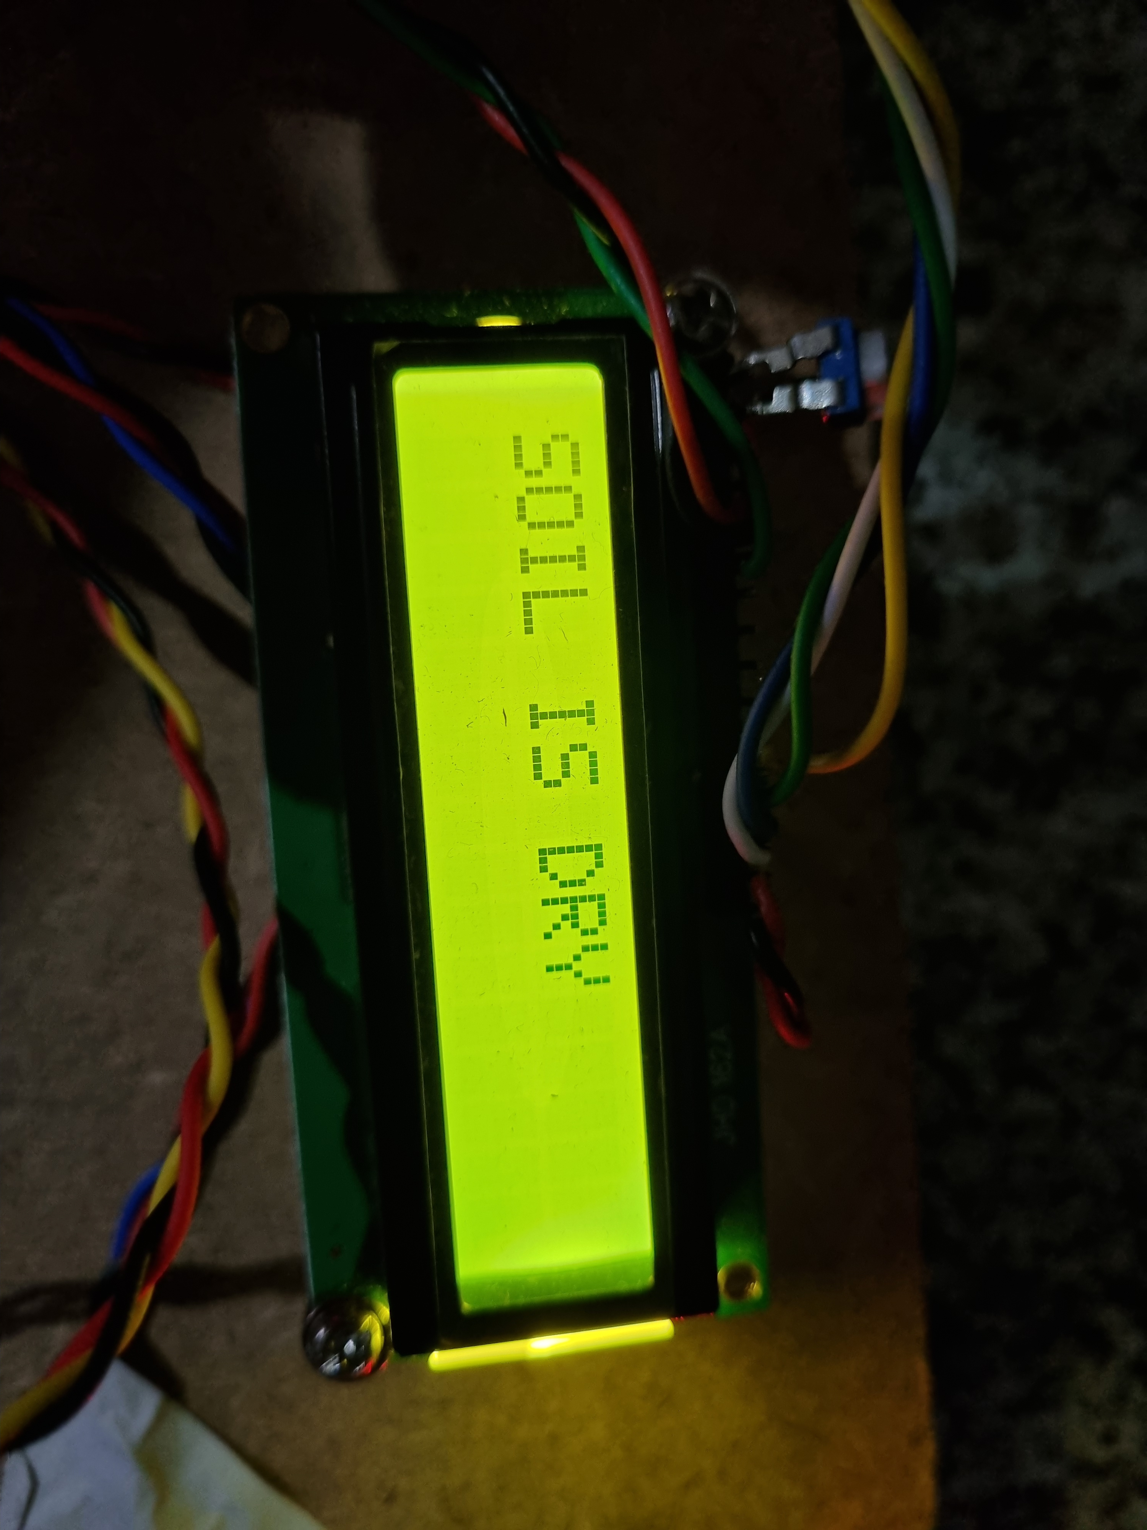
Experimental Results
LCD Display when the Soil is Dry
LCD Display with T , H and NPK values

Slide 18
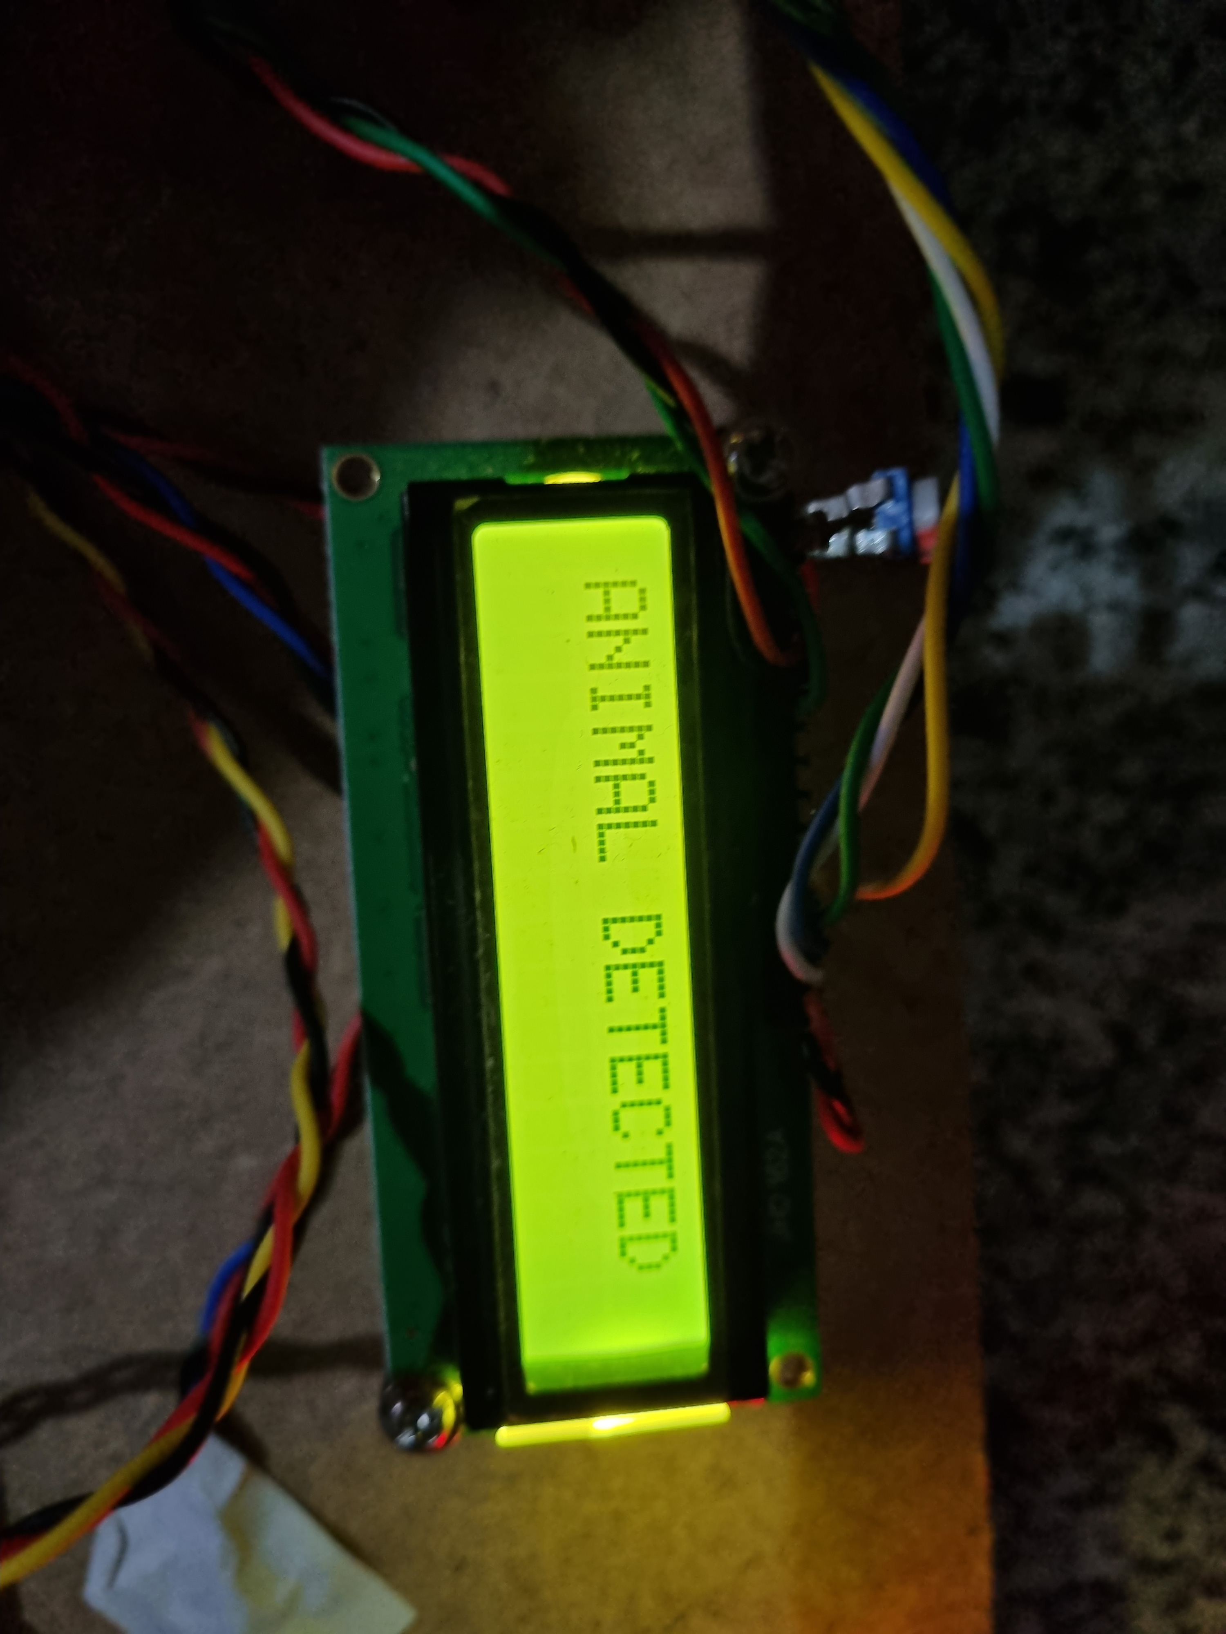
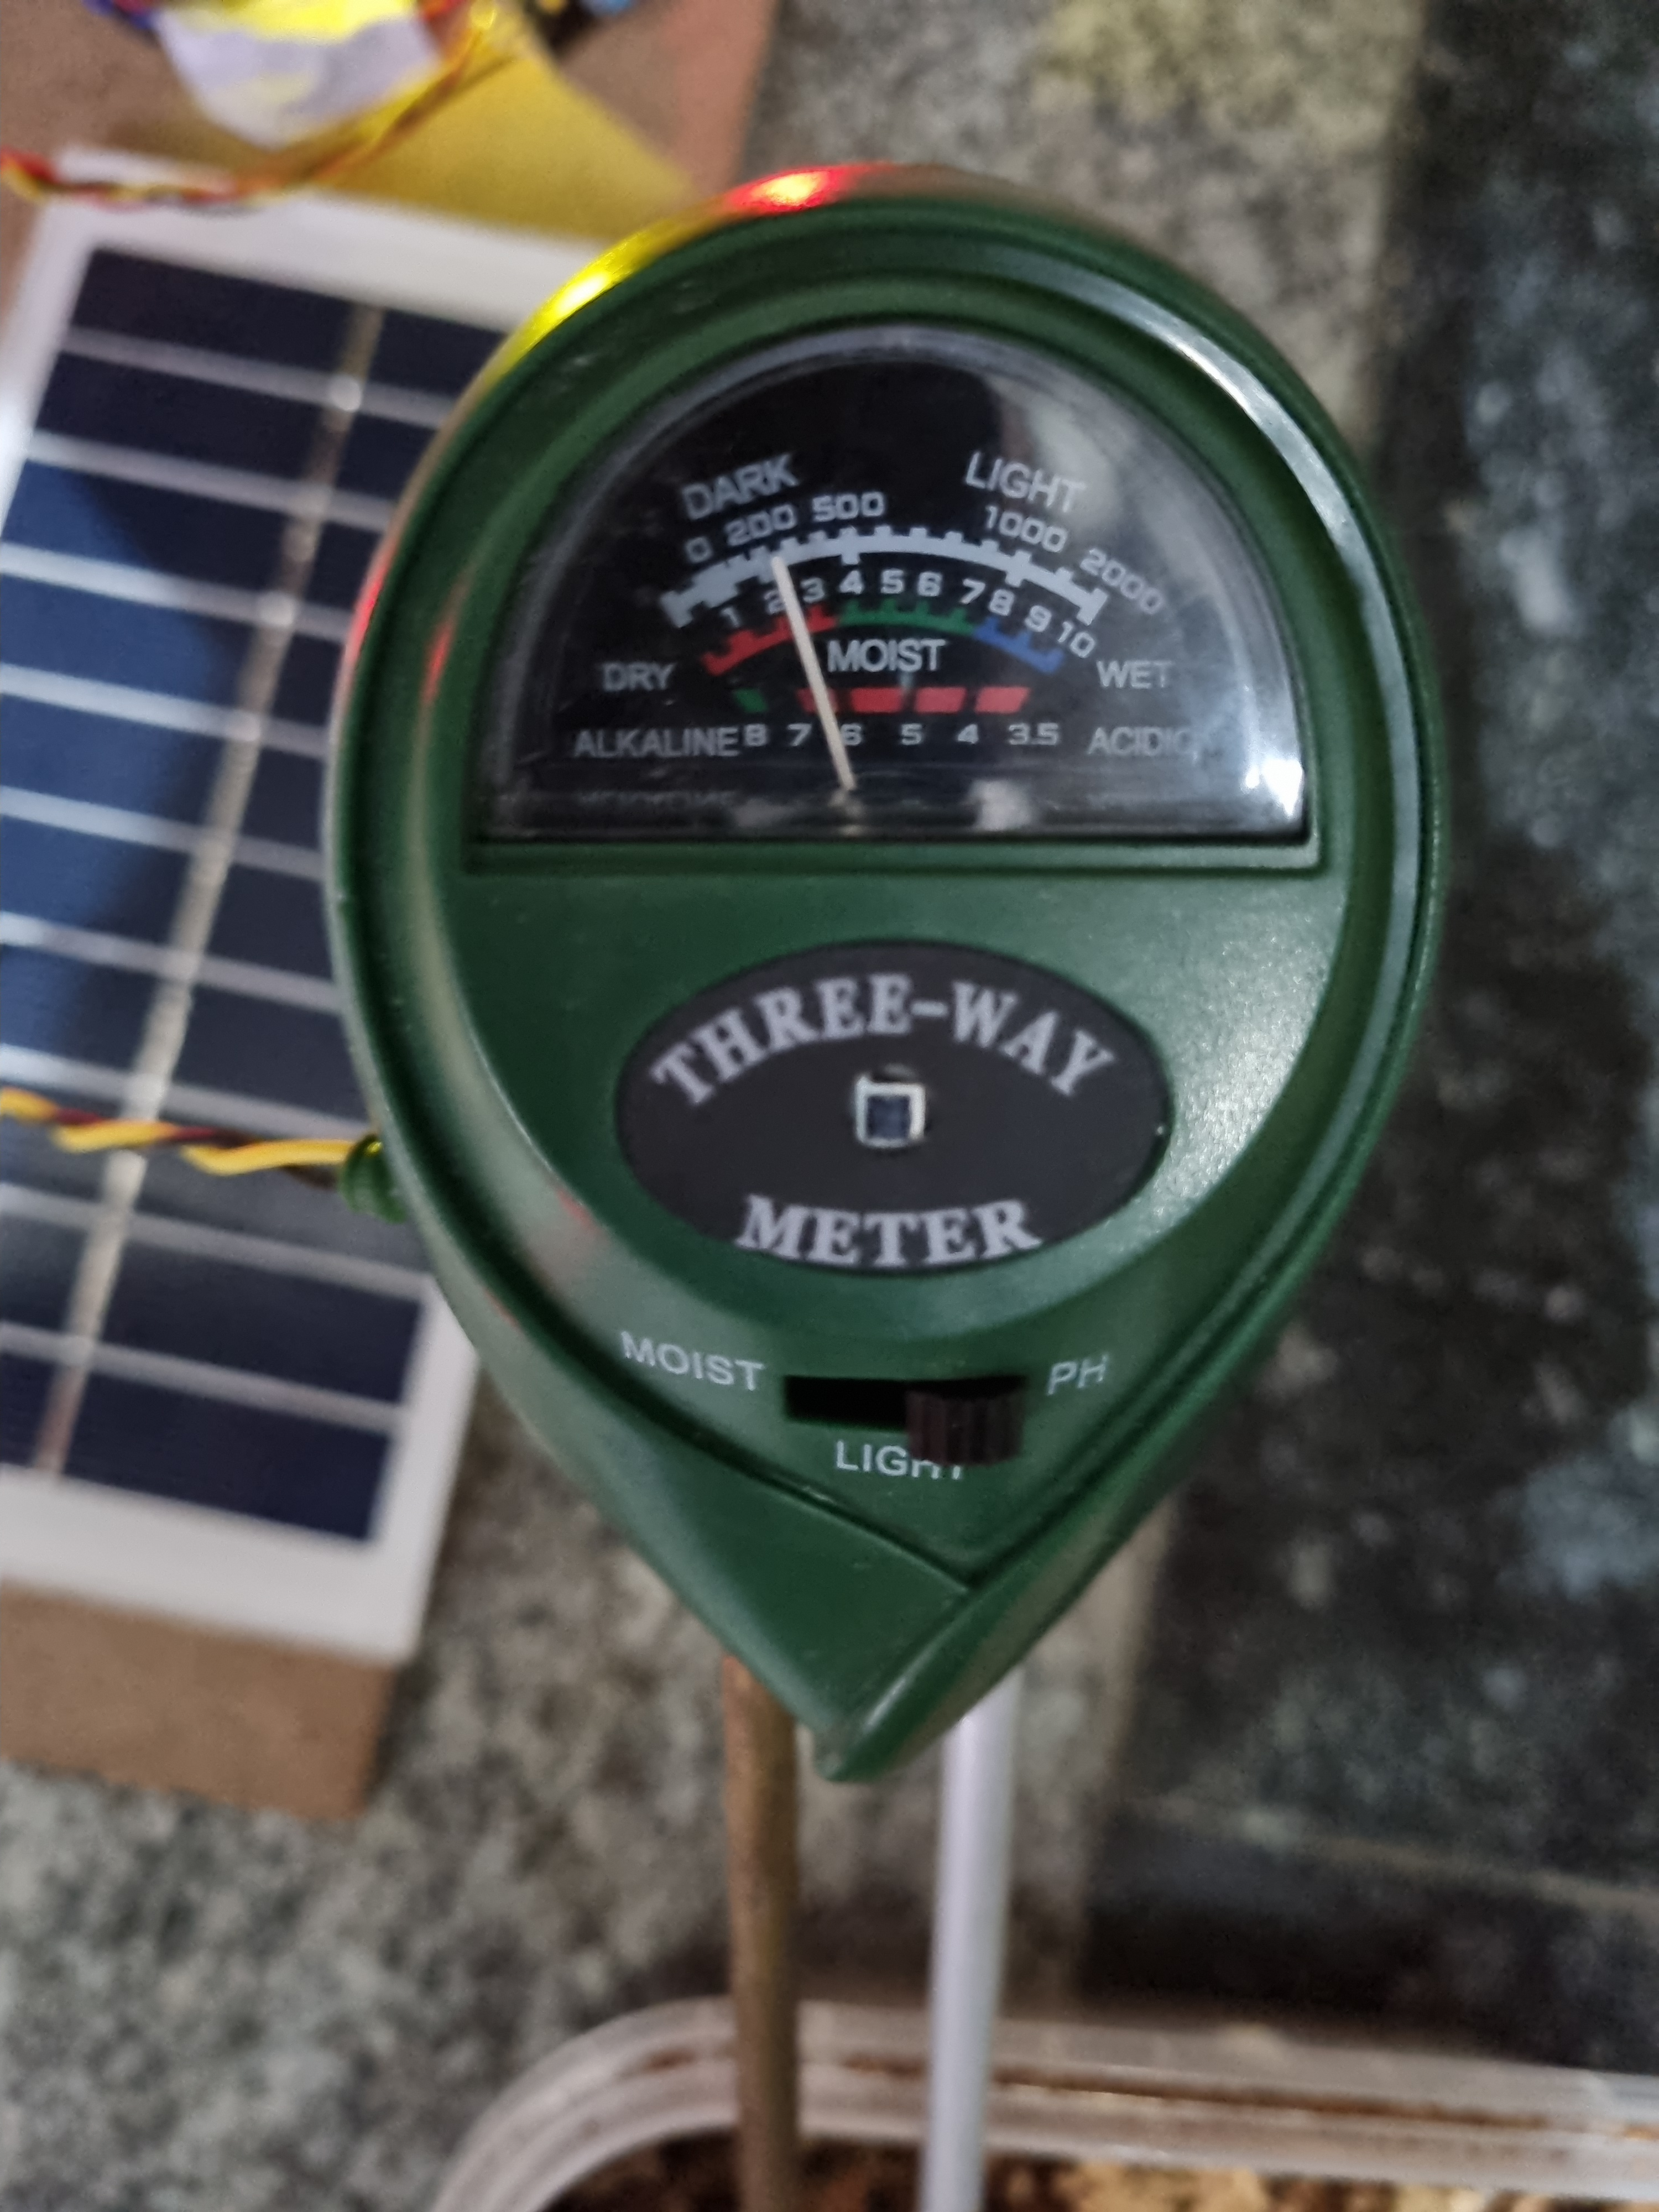
Experimental Results
pH Value of the soil
LCD Display when Animal is Detected

Slide 19
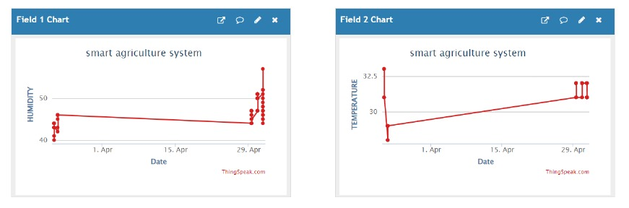
Experimental Results
Real Time Graphical Representation of Humidity value in soil
Real Time Graphical Representation of Temperature value in soil

Slide 20
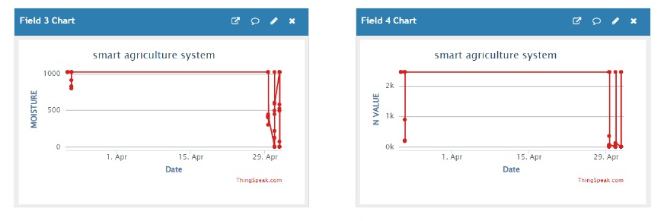
Experimental Results
Real Time Graphical Representation of Moisture value in soil
Real Time Graphical Representation of Nitrogen(N) value in soil

Slide 21
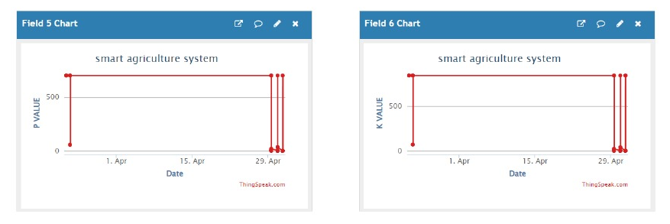
Experimental Results
Real Time Graphical Representation of Phosphorous(P) value in soil
Real Time Graphical Representation of Potassium(K) value in soil

Slide 22
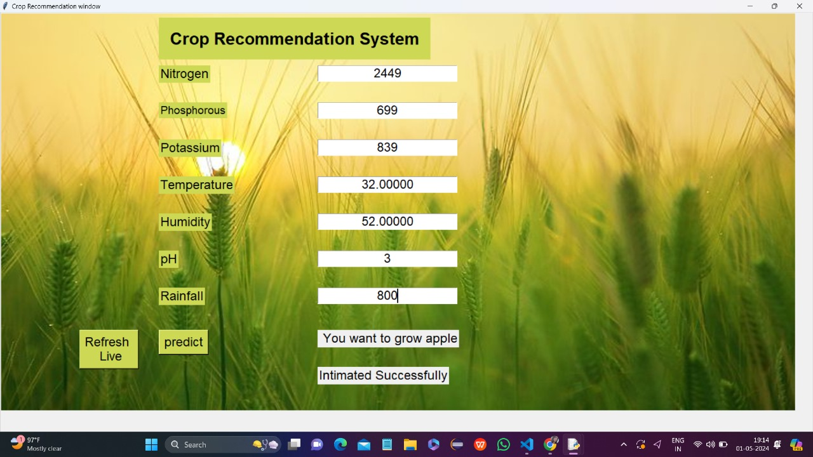
Experimental Results
Crop Recommendation Results

Slide 23
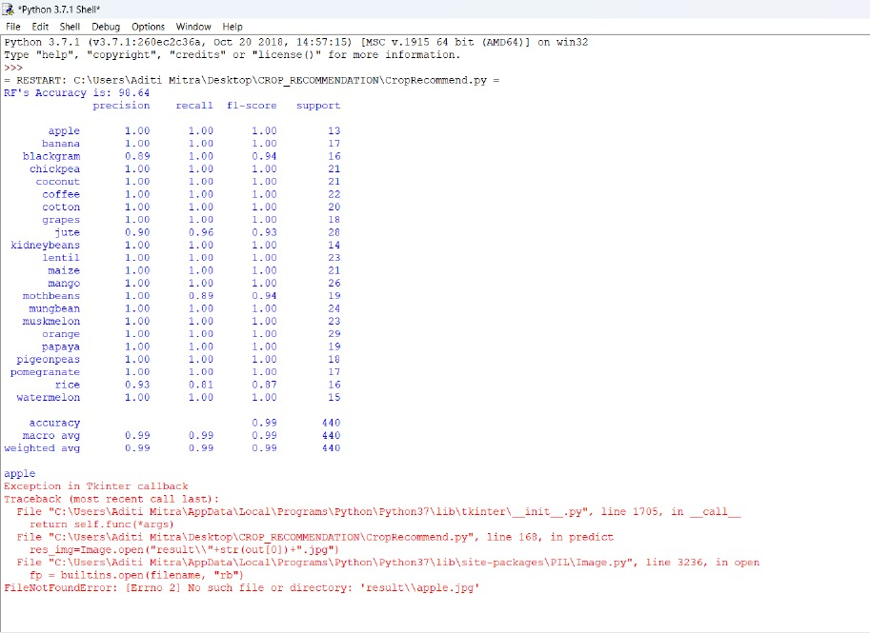
Experimental Results
Crop Recommendation Prediction Results

Slide 24
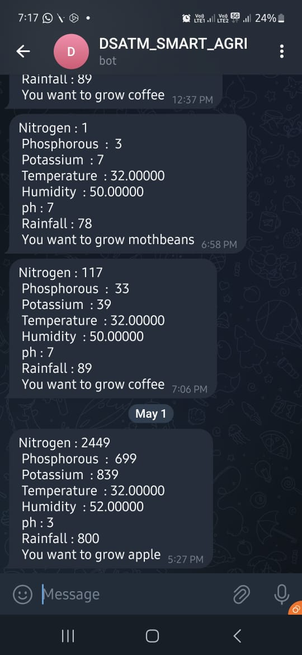
Experimental Results
Alert Messages on Telegram

Slide 25
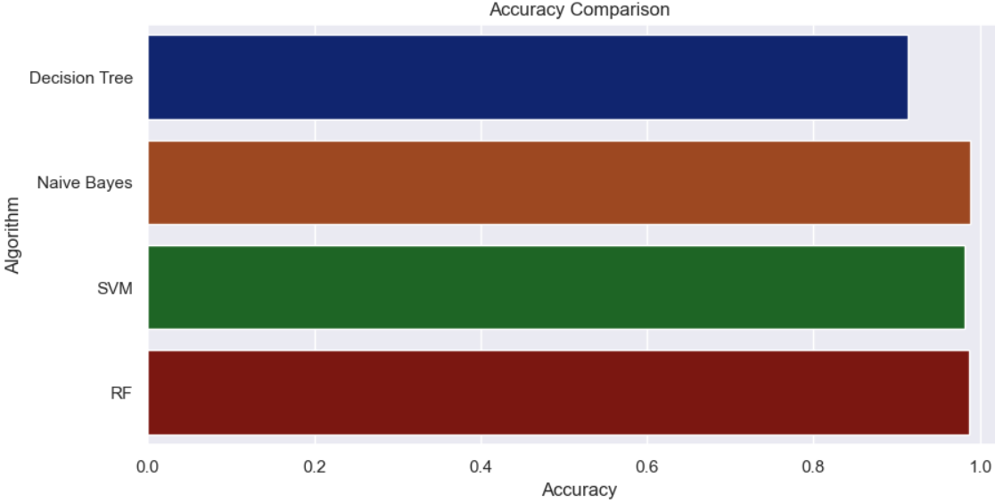
Quality Metrics
Accuracy of different ML Models trained for Crop Prediction

Slide 26
Quality Metrics
Decision Tree
 | precision | recall | f1-score | support
apple | 1.00 | 1.00 | 1.00 | 13
banana | 1.00 | 1.00 | 1.00 | 17
blackgram | 0.64 | 1.00 | 0.78 | 16
chickpea | 1.00 | 1.00 | 1.00 | 21
coconut | 1.00 | 1.00 | 1.00 | 21
coffee | 1.00 | 0.95 | 0.98 | 22
cotton | 1.00 | 1.00 | 1.00 | 20
grapes | 1.00 | 1.00 | 1.00 | 18
jute | 1.00 | 0.21 | 0.35 | 28
kidneybeans | 1.00 | 0.79 | 0.88 | 14
lentil | 1.00 | 0.96 | 0.98 | 23
maize | 0.83 | 0.95 | 0.89 | 21
mango | 1.00 | 0.92 | 0.96 | 26
mothbeans | 0.92 | 0.58 | 0.71 | 19
mungbean | 1.00 | 1.00 | 1.00 | 24
muskmelon | 1.00 | 1.00 | 1.00 | 23
orange | 1.00 | 1.00 | 1.00 | 29
papaya | 1.00 | 1.00 | 1.00 | 19
pigeonpeas | 0.90 | 1.00 | 0.95 | 18
pomegranate | 1.00 | 1.00 | 1.00 | 17
rice | 0.42 | 1.00 | 0.59 | 16
watermelon | 1.00 | 1.00 | 1.00 | 15
accuracy |  |  | 0.91 | 440
Macro avg | 0.94 | 0.93 | 0.91 | 440
Weighted avg | 0.95 | 0.91 | 0.91 | 440

Slide 27
Quality Metrics
Gaussian Naïve Bayes
 | precision | recall | f1-score | support
apple | 1.00 | 1.00 | 1.00 | 13
banana | 1.00 | 1.00 | 1.00 | 17
blackgram | 0.64 | 1.00 | 0.78 | 16
chickpea | 1.00 | 1.00 | 1.00 | 21
coconut | 1.00 | 1.00 | 1.00 | 21
coffee | 1.00 | 0.95 | 0.98 | 22
cotton | 1.00 | 1.00 | 1.00 | 20
grapes | 1.00 | 1.00 | 1.00 | 18
jute | 1.00 | 0.21 | 0.35 | 28
kidneybeans | 1.00 | 0.79 | 0.88 | 14
lentil | 1.00 | 0.96 | 0.98 | 23
maize | 0.83 | 0.95 | 0.89 | 21
mango | 1.00 | 0.92 | 0.96 | 26
mothbeans | 0.92 | 0.58 | 0.71 | 19
mungbean | 1.00 | 1.00 | 1.00 | 24
muskmelon | 1.00 | 1.00 | 1.00 | 23
orange | 1.00 | 1.00 | 1.00 | 29
papaya | 1.00 | 1.00 | 1.00 | 19
pigeonpeas | 0.90 | 1.00 | 0.95 | 18
pomegranate | 1.00 | 1.00 | 1.00 | 17
rice | 0.42 | 1.00 | 0.59 | 16
watermelon | 1.00 | 1.00 | 1.00 | 15
accuracy |  |  | 0.91 | 440
Macro avg | 0.94 | 0.93 | 0.91 | 440
Weighted avg | 0.95 | 0.95 | 0.91 | 0.91

Slide 28
Quality Metrics
Support Vector Machine
 | precision | recall | f1-score | support
apple | 1.00 | 1.00 | 1.00 | 13
banana | 1.00 | 1.00 | 1.00 | 17
blackgram | 0.94 | 1.00 | 0.97 | 16
chickpea | 1.00 | 1.00 | 1.00 | 21
coconut | 1.00 | 1.00 | 1.00 | 21
coffee | 1.00 | 1.00 | 1.00 | 22
cotton | 1.00 | 1.00 | 1.00 | 20
grapes | 1.00 | 1.00 | 1.00 | 18
jute | 0.93 | 0.89 | 0.91 | 28
kidneybeans | 1.00 | 1.00 | 1.00 | 14
lentil | 1.00 | 1.00 | 1.00 | 23
maize | 1.00 | 1.00 | 1.00 | 21
mango | 0.93 | 1.00 | 0.96 | 26
mothbeans | 1.00 | 0.84 | 0.91 | 19
mungbean | 1.00 | 1.00 | 1.00 | 24
muskmelon | 1.00 | 1.00 | 1.00 | 23
orange | 1.00 | 1.00 | 1.00 | 29
papaya | 1.00 | 1.00 | 1.00 | 19
pigeonpeas | 1.00 | 1.00 | 1.00 | 18
pomegranate | 1.00 | 1.00 | 1.00 | 17
rice | 0.82 | 0.88 | 0.85 | 16
watermelon | 1.00 | 1.00 | 1.00 | 15
accuracy |  |  | 0.98 | 440
Macro avg | 0.98 | 0.98 | 0.98 | 440
Weighted avg | avg | 0.98 | 0.98 | 440

Slide 29
Quality Metrics
Random Forest
 | precision | recall | f1-score | support
apple | 1.00 | 1.00 | 1.00 | 13
banana | 1.00 | 1.00 | 1.00 | 17
blackgram | 0.89 | 1.00 | 0.94 | 16
chickpea | 1.00 | 1.00 | 1.00 | 21
coconut | 1.00 | 1.00 | 1.00 | 21
coffee | 1.00 | 1.00 | 1.00 | 22
cotton | 1.00 | 1.00 | 1.00 | 20
grapes | 1.00 | 1.00 | 1.00 | 18
jute | 0.90 | 0.96 | 0.93 | 28
kidneybeans | 1.00 | 1.00 | 1.00 | 14
lentil | 1.00 | 1.00 | 1.00 | 23
maize | 1.00 | 1.00 | 1.00 | 21
mango | 1.00 | 1.00 | 1.00 | 26
mothbeans | 1.00 | 0.89 | 0.94 | 19
mungbean | 1.00 | 1.00 | 1.00 | 24
muskmelon | 1.00 | 1.00 | 1.00 | 23
orange | 1.00 | 1.00 | 1.00 | 29
papaya | 1.00 | 1.00 | 1.00 | 19
pigeonpeas | 1.00 | 1.00 | 1.00 | 18
pomegranate | 1.00 | 1.00 | 1.00 | 17
rice | 0.93 | 0.81 | 0.87 | 16
watermelon | 1.00 | 1.00 | 1.00 | 15
accuracy |  |  | 0.99 | 440
Macro avg | 0.99 | 0.99 | 0.99 | 440
weighted | avg | 0.99 | 0.99 | 0.99

Slide 30
MODEL NAME | ACCURACY
Decision Tree | 91.36%
Gaussian Naïve Bayes | 98.86%
Support Vector Machine | 98.18%
Random Forest | 98.63% (used)
Accuracy of different ML models
Sensor Name | Working Range/ Accuracy
DHT11 | 20-90%RH ±5％RH 0-50 C ±2℃
Moisture | Dry: 10K-100K ohms Wet: <10K ohms
IR | 20-25 cm
pH | 5.5 -6.5 (Std.)
Reason to use Random Forest Model:
Handling of Non-linear Relationships.
Robustness to Outliers.
No Assumption of Feature Independence
Performance on Imbalanced Datasets

Slide 31
Conclusion
In summary, the integration of renewable energy into cloud and IoT-based smart agriculture represents a pivotal step towards sustainable and efficient farming practices. This amalgamation not only mitigates the environmental impact of traditional agriculture but also enhances productivity through real-time data analytics and precision farming. By leveraging renewable energy sources, such as solar and wind power, alongside cloud computing and IoT technologies, farmers can optimize resource utilization, reduce operational costs, and foster resilient agricultural systems. This transformative synergy not only addresses the challenges faced by conventional farming but also contributes to environmental conservation, economic growth, and inclusive development in the agriculture sector, promising a greener and more prosperous future for global food production.

Slide 32
References
[1] Sanket C.Mungale1, M. Sankar2, Deepak Khot3, R.Parvathi4, D.N.Mudgal5,”An Effiecient Smart Irrigation System for Solar System by using PIC and GSM”, Proceedings of the Fifth International Conference on Inventive Computation Technologies (ICICT-2022) IEEE Xplore Part Number:CFP20F70-ART; ISBN:978-1-7281-4685-0
[2]. Sudharshan N, AVS Kasturi Karthik, JS Sandeep Kiran, S.Geetha* “Renewable Energy Based Smart Irrigation System”, INTERNATIONAL CONFERENCE ON RECENT TRENDS IN ADVANCED COMPUTING 2021, ICRTAC 2021
[3]. S. Mukhopadhyay, A. R. Al-Ali, M. Shihab, S. Fernandes, K. Ailabouni: Renewable Energy Based Smart Irrigation System
[4]. Flora, C.B. (2020) “Food security in the context of energy and resource depletion: Sustainable agriculture in developing countries” Renewable Agriculture and Food Systems, Cambridge University Press 25 (2): 118–128
[5]. Hemming, J. and Rath, T. (2021) “PA—Precision Agriculture: Computer-Vision-based Weed Identification under Field Conditions using Controlled Lighting” Journal of Agricultural Engineering Research 78 (3): 233–243.

Slide 33
[6]. Nalliah, V., Ranjan, R.S. and Kahimba, F.C. (2021) “Evaluation of a plant-controlled subsurface drip irrigation system” Biosystems Engineering 102 (3): 313–320.
[7] “Solar Energy Perspectives: govt Summary" (PDF). International Energy Agency. 2011. Archived from the initial (PDF) on 3 solar calendar month 2021. "Energy". rsc.org. 2014-04-02.
[8]. 2014 Key World Energy Statistics" (PDF). iea.org. IEA. 2014. pp. 6, 24,28. Archived (PDF) from the initial on 5 would possibly 2021.
[9] Energy and additionally the challenge of sustainability" (PDF). International organisation Development Program and World Energy Council. Gregorian calendar month 2020. Retrieved seventeen January 2017. Smil (2020), p. 240
[10] A Suresh Kumar “Smart Irrigation System with Solar Power”, IOP Conference Series: Materials Science and Engineering et al 2021 IOP Conf. Ser.: Mater. Sci. Eng. 1145 012058

